Slide 1
Unit-3
Cont…

Slide 2
Functional dependency
A functional dependency is a constraint that specifies the relationship between two sets of attributes where one set can accurately determine the value of other sets.
A functional dependency is denoted by an arrow “→”. The functional dependency X → Y, where X is a set of attributes that is capable of determining the value of Y.
The attribute set on the left side of the arrow, X is called Determinant, while on the right side, Y is called the Dependent.
Functional dependencies are used to mathematically express relations among database entities and are very important to understand advanced concepts in Relational Database System

Slide 3
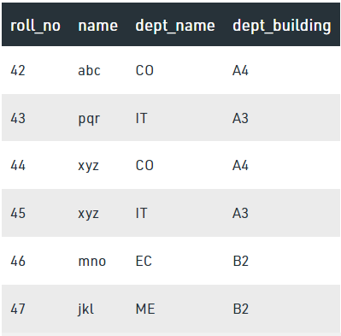
From the table we can conclude some valid functional dependencies: roll_no → { name, dept_name, dept_building }, Here, roll_no can determine values of fields name, dept_name and dept_building, roll_no → dept_name , Since, roll_no can determine whole set of {name, dept_name, dept_building}, it can determine its subset dept_name also. dept_name → dept_building , Dept_name can identify the dept_building accurately, since departments with different dept_name will also have a different dept_building More valid functional dependencies: roll_no → name, {roll_no, name} ⇢ {dept_name, dept_building}, etc.

Slide 4
Armstrong’s axioms/properties of functional dependencies:
Reflexivity: If Y is a subset of X, then X→Y holds by reflexivity rule
For example, {roll_no, name} → name is valid.
Augmentation: If X → Y is a valid dependency, then XZ → YZ is also valid by the augmentation rule.
For example, If {roll_no, name} → dept_building is valid, hence {roll_no, name, dept_name} → {dept_building, dept_name} is also valid.→
Transitivity: If X → Y and Y → Z are both valid dependencies, then X→Z is also valid by the Transitivity rule.
For example, roll_no → dept_name & dept_name → dept_building, then roll_no → dept_building is also valid.

Slide 5
Types of Functional dependencies
Trivial functional dependency
Non-Trivial functional dependency
Multivalued functional dependency
Transitive functional dependency

Slide 6
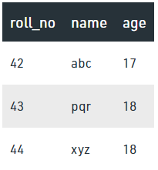
1. Trivial Functional Dependency
In Trivial Functional Dependency, a dependent is always a subset of the determinant.
i.e. If X → Y and Y is the subset of X, then it is called trivial functional dependency
Here, {roll_no, name} → name is a trivial functional dependency, since the dependent name is a subset of determinant set {roll_no, name}
Similarly, roll_no → roll_no is also an example of trivial functional dependency.

Slide 7
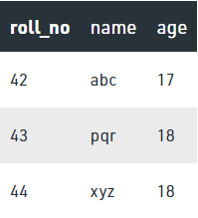
2. Non-trivial Functional Dependency
In Non-trivial functional dependency, the dependent is strictly not a subset of the determinant.
i.e. If X → Y and Y is not a subset of X, then it is called Non-trivial functional dependency.
Here, roll_no → name is a non-trivial functional dependency, since the dependent name is not a subset of determinant roll_no
Similarly, {roll_no, name} → age is also a non-trivial functional dependency, since age is not a subset of {roll_no, name}

Slide 8
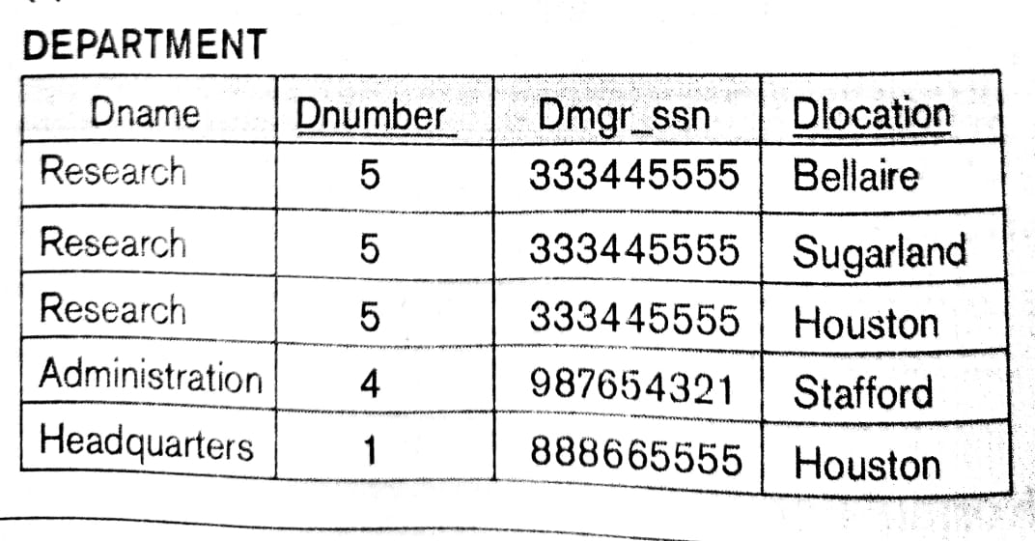

Slide 9
3. Multivalued Functional Dependency
In Multivalued functional dependency, entities of the dependent set are not dependent on each other.
i.e. If a → {b, c} and there exists no functional dependency between b and c, then it is called a multivalued functional dependency.
It is represented by ->> Double Arrow
Ex.
In the previous table DNumber -> Dname, Dnumber -> Dlocation But there is dependency between Dname and Dlocation, So Dnumber ->> DLocation

Slide 10
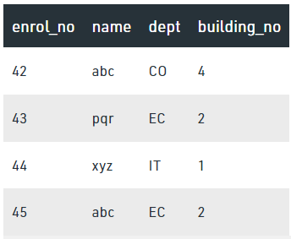
4. Transitive Functional Dependency
In transitive functional dependency, dependent is indirectly dependent on determinant.
i.e. If a → b & b → c, then according to axiom of transitivity, a → c. This is a transitive functional dependency
Here, enrol_no → dept and dept → building_no,
Hence, according to the axiom of transitivity,
enrol_no → building_no is a valid functional dependency.
This is an indirect functional dependency, hence called Transitive functional dependency.

Slide 11
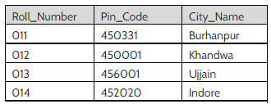
Transitive FD example
From above table,
Roll_Number --> Pin_Code and Pin_Code --> City_Name hold.
Than Roll_Number --> City_Name is a transitive FD.

Slide 12
Normalization:
It is the process of decomposing unsatisfactory "bad“ relations by breaking up their attributes into smaller relations
Normalization is carried out in practice so that the resulting designs are of high quality and meet the desirable properties
Normal form:
Condition using keys and FDs of a relation to certify whether a relation schema is in a particular normal form

Slide 13
Definitions of Keys and Attributes Participating in Keys
A super key of a relation schema R = {A1, A2, ...., An} is a set of attributes S subset-of R with the property that no two tuples t1 and t2 in any legal relation state r of R will have t1[S] = t2[S]
A Candidate key K is a super key with the additional property that removal of any attribute from K will cause K not to be a super key any more.
OR
Minimal Super Key with unique and not null values can be a candidate key
One of the candidate keys is arbitrarily designated to be the primary key, and the others are called secondary Keys / Alternate Keys
A Prime attribute must be a member of some candidate key
A Nonprime attribute is not a prime attribute— that is, it is not a member of any candidate key

Slide 14
Normalization
First Normal Form: This rule defines that all the attributes in a relation must have atomic domains. The values in an atomic domain are indivisible units.
Eg.
Convert into 1st NF as:
{Car_Model, Color, Price} with multiple records for Car Model
Here in 1st NF we don’t create any Primary key.
Car_model | Color | Price
1 | Red, Grey, Black | 5lk , 6lk , 4.5lk
2 | Red, Yellow, White | 5.5 lk , 4lk, 6lk
3 | Black, White | 7lk , 6lk
4 | White, Grey | 6lk , 7lk

Slide 15
Cont…
Second Normal Form:
Every non-prime attribute should be fully functionally dependent on prime key attribute.
That is, if X → A holds, then there should not be any proper subset Y of X, for which Y → A also holds true.
Eg.
Stud_Proj: {stud_id, name, proj_id, proj_name}
Student: {stud_Id, name, proj_Id,}
Project: {proj_id, proj_name}

Slide 16
Cont…
Third Normal Form:
For a relation to be in Third Normal Form, it must be in Second Normal form and the following must satisfy
No non-prime attribute is transitively dependent on prime key attribute.
For any non-trivial functional dependency,
X → A, then either
X is a superkey or
A is prime attribute.

Slide 17
StudentID | StudentName | CourseID | CourseName | CourseFee | InstructorName | InstructorPhone
1 | Amit | C101 | DBMS | 5000 | Prof. Mehta | 9876543210
2 | Rina | C102 | Python | 6000 | Prof. Shah | 9876543222
3 | Kiran | C101 | DBMS | 5000 | Prof. Mehta | 9876543210
Step 1: Check 1NF
All attributes contain atomic values. Already in 1NF.

Slide 18
Step 2: Check 2NF
Primary Key could be (StudentID, CourseID).
CourseName, CourseFee, InstructorName, InstructorPhone depend only on CourseID,
not on StudentID → partial dependency.
So, split into two tables:
StudentID | StudentName | CourseID
1 | Amit | C101
2 | Rina | C102
3 | Kiran | C101
CourseID | CourseName | CourseFee | InstructorName | InstructorPhone
C101 | DBMS | 5000 | Prof. Mehta | 9876543210
C102 | Python | 6000 | Prof. Shah | 9876543222

Slide 19
Step 3: Check 3NF
In COURSE table, InstructorPhone depends on InstructorName, not directly on CourseID.
This is a transitive dependency.
StudentID | StudentName | CourseID
1 | Amit | C101
2 | Rina | C102
3 | Kiran | C101
Decompose to 3NF
We create a separate INSTRUCTOR Table.
CourseID | CourseName | CourseFee | InstructorName
C101 | DBMS | 5000 | Prof. Mehta
C102 | Python | 6000 | Prof. Shah
InstructorName | InstructorPhone
Prof. Mehta | 9876543210
Prof. Shah | 9876543222

